Slide 1


Risk Management for Projects
Said Fawzy
Section 5:
Risk monitor and review

Slide 2
Module Contents
Communication and reporting
Monitor and review
Discussion: Risk monitor and review
FAQs
Course summary

Slide 3
1 Communication
and reporting

Slide 4
What you will learn in this section
In this section, you will learn how to:
Recognise the importance of a monitor and review process
Use a monitor and review process
Integrate a monitor and review process that sets targets
Obtain and use feedback for continuous improvement, and
Select steps for continuous improvement.

Slide 5
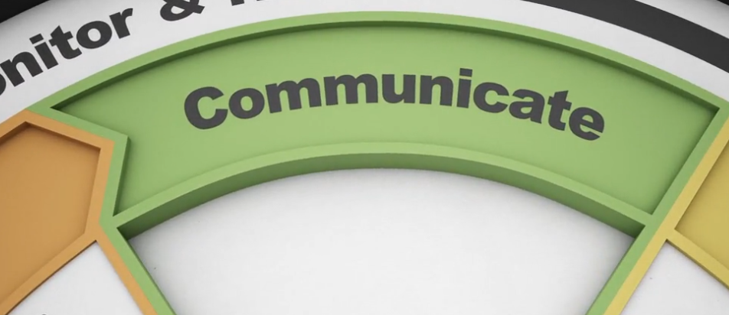
Risk management canvas on communication
The most important activity in executing a successful risk management strategy.
Communicating the identified risks, risk assessments, and risk responses you developed in your risk register to the relevant stakeholders

Slide 6


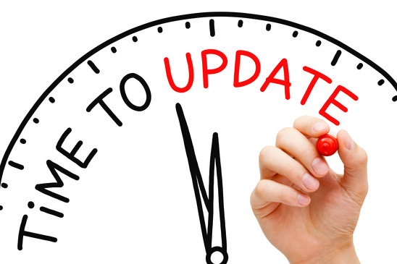


Communicating need to occur
Formally

Slide 7
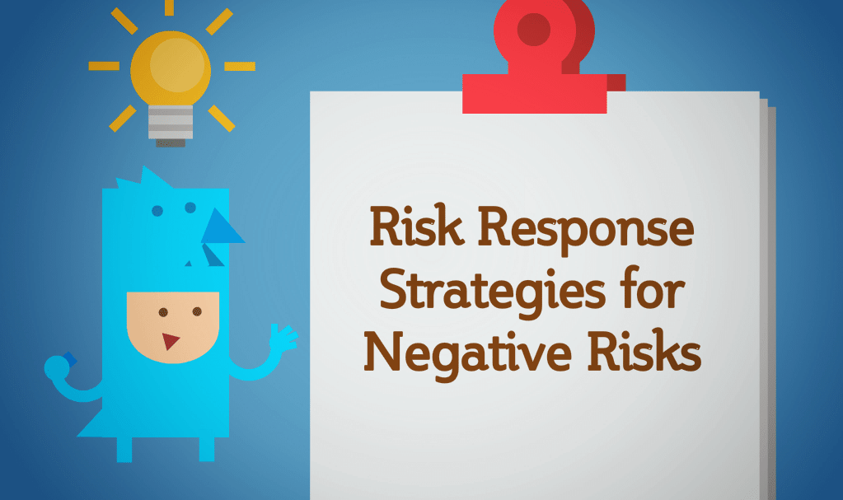
All stakeholders must be aware of the risks and response strategies.

Slide 8
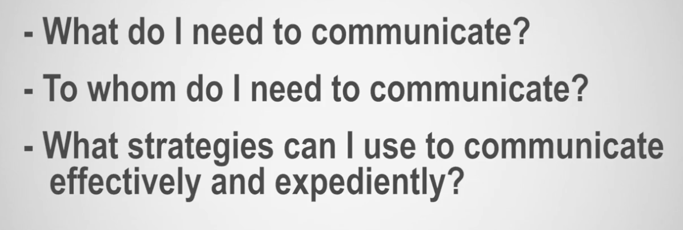
Key considerations you now need to deal with are...

Slide 9
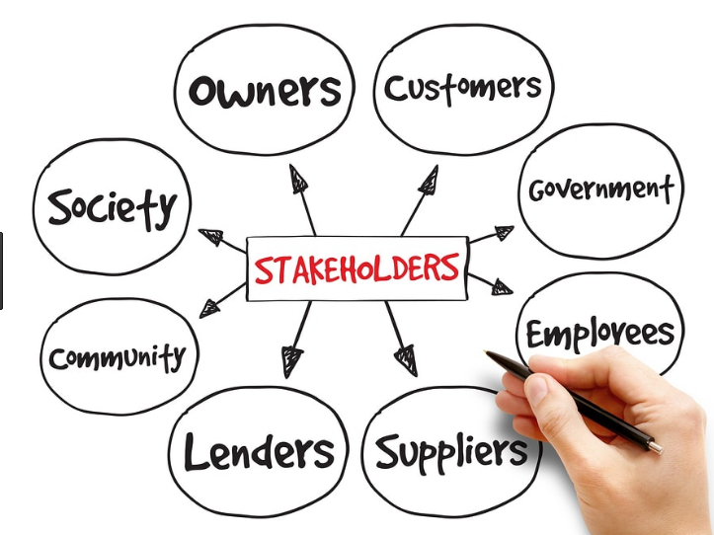
Reporting to internal and external stakeholders
Implementing the various risk response activities involves a range of project stakeholders, and does not rely solely on you as the project manager.

Slide 10

Reporting to internal and external stakeholders
You will get much more commitment from people if you allow them to participate in your processes

Slide 11

Reporting to internal and external stakeholders
When people co-create things, they usually feel that they have been heard, and their buy-in ensures positive engagement and accountability.

Slide 12
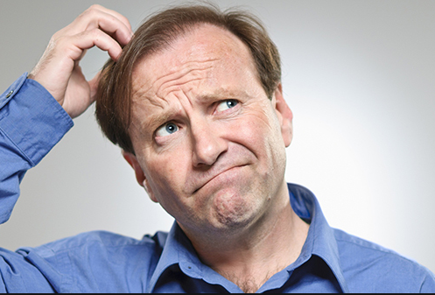

Reporting to internal and external stakeholders
Effective communication in reporting ensures that those responsible for implementing risk management actions understand the context and basis on which decisions are made, and the reasons why particular treatment options have been selected.

Slide 13
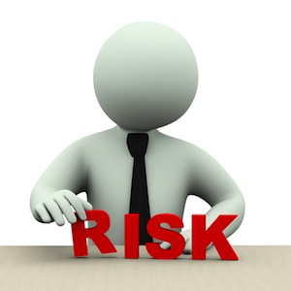






Reporting Risk ?
We cannot send hundreds of risk response and mitigation update activities to all stakeholders every week.

Slide 14
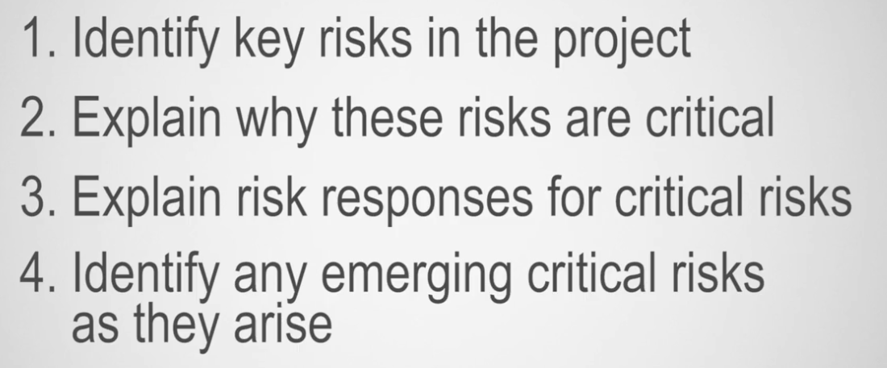
So what information would enable effective risk reporting?

Slide 15


Internal stakeholders
Organization
Structure
Your team
You

Slide 16

Internal stakeholders
A structured process of communication and reporting needs to be in place to ensure that communication takes place regularly.

Slide 17

Internal stakeholders
A reporting structure ensures that all internal stakeholders are informed and up to date on risks and risk treatment throughout the project lifecycle.

Slide 18
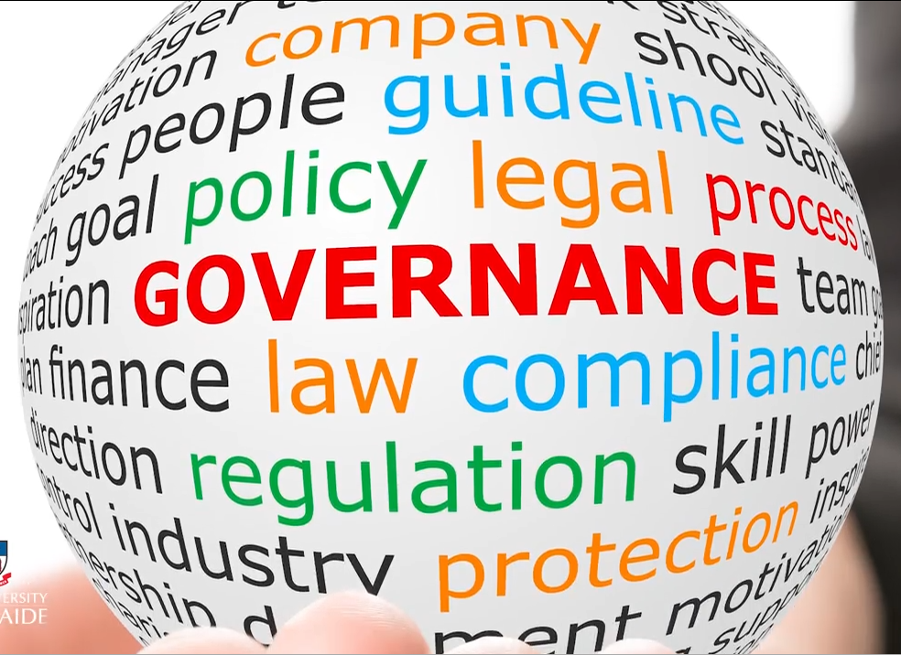
External Stakeholders:
You also have the responsibility of reporting to your external stakeholders or agencies that are involved in or have an interest in your project.
External reporting should follow a formal structured approach.

Slide 19

Filter Data:
You would typically filter the information to external stakeholders based on their interest and influence in the project.

Slide 20
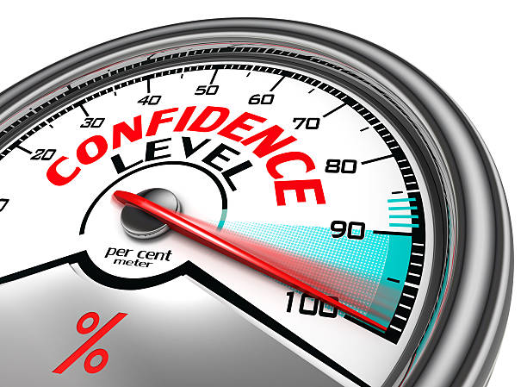
Why formal and frequent risk reporting to your stakeholders ?
Demonstrate the effectiveness of your risk management processes.
Raising their level of confidence in the organization.

Slide 21

Create Reporting structure:

Slide 22



Develop a formal communication and reporting structure
The structure will identify:
Levels of authority
Accountability
Responsibility

Slide 23







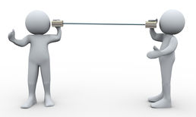
Reporting Structure:

Slide 24
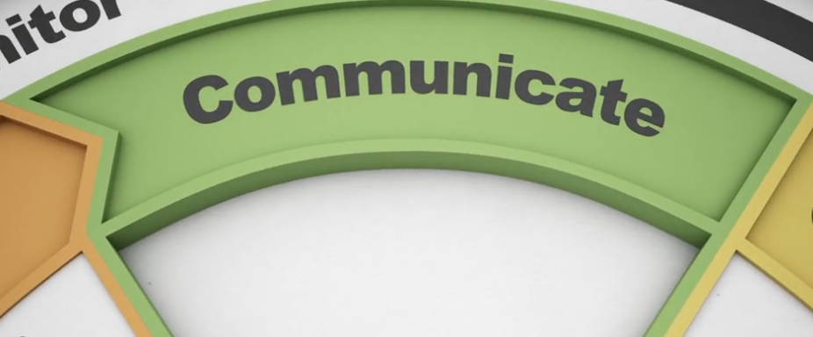

Communicating and reporting risk activities
As a project or risk manager it is worth reviewing the existing communication procedures, and if necessary, developing your own project communication procedures to be fit for purpose.

Slide 25


Channels of communicating:

Slide 26
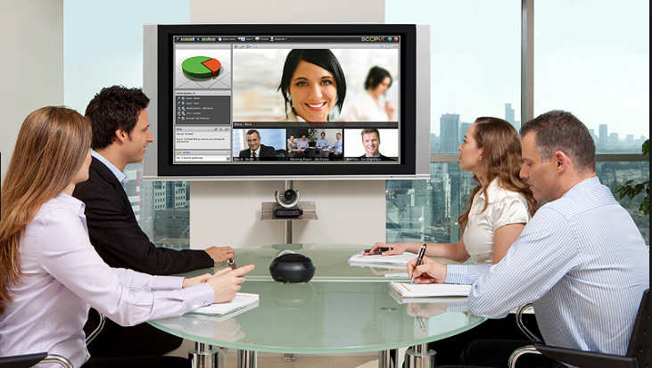

Channels of communicating:

Slide 27
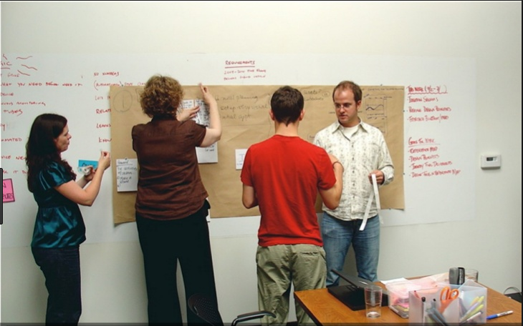

Channels of communicating:

Slide 28
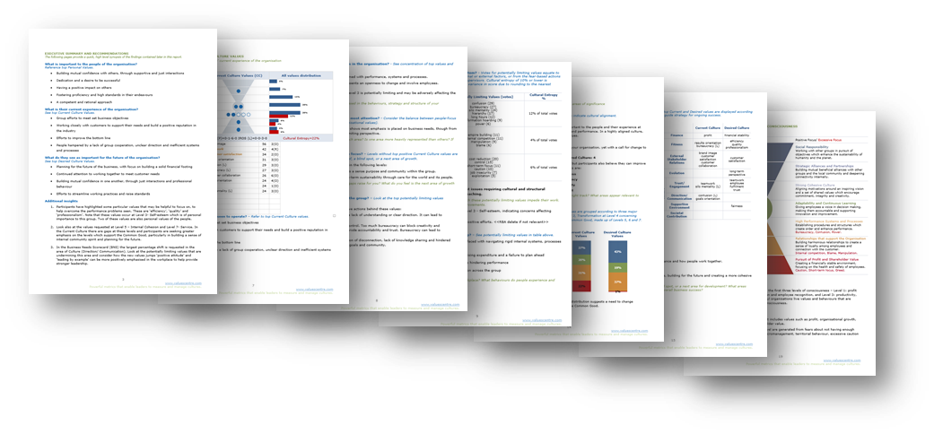

Channels of communicating:

Slide 29

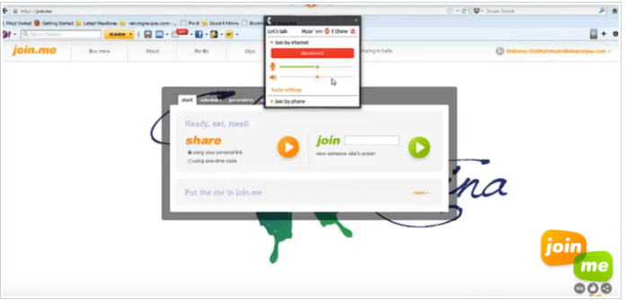

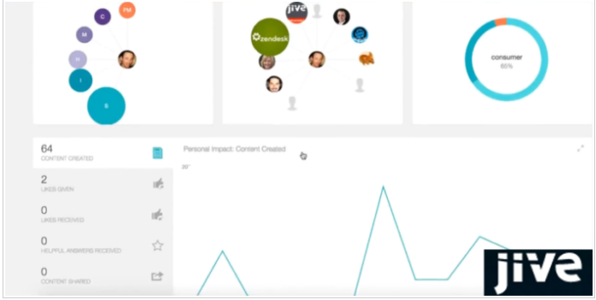
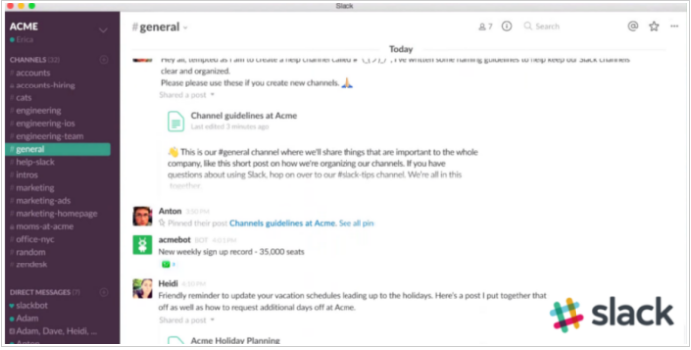
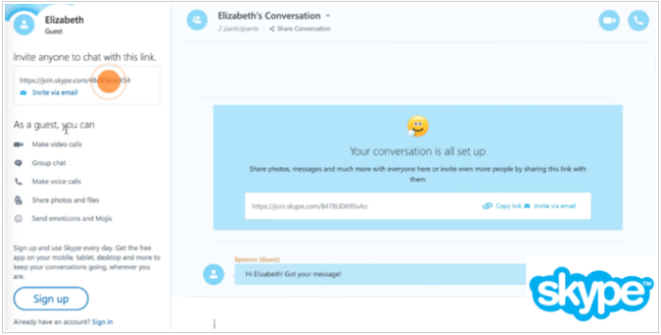
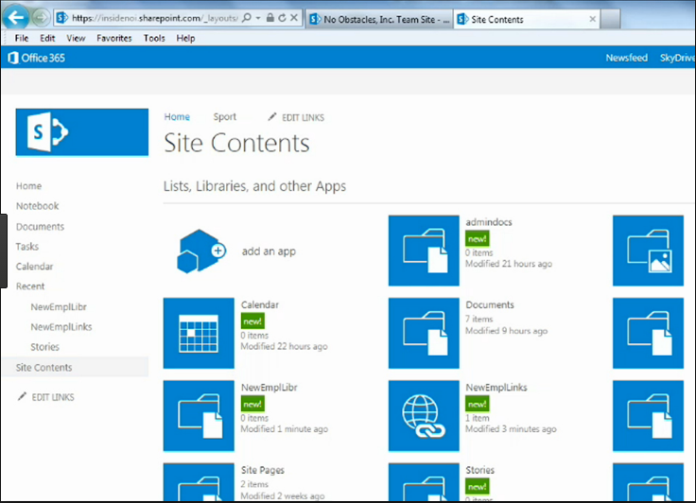

Channels of communicating:
SharePoint
Drop
Box
Google
Drive
One
Drive

Slide 30
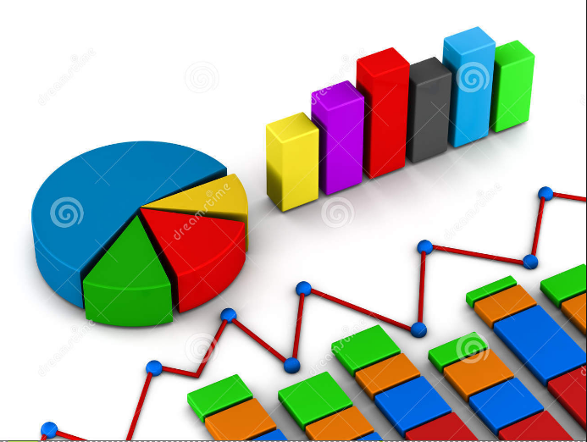

Channels of communicating:

Slide 31
Channels of communicating:

Slide 32

Face to face meetings :
remain the most effective forms of communication

Slide 33

Meetings held at regular intervals :
To keep key stakeholders informed of ongoing risk exposures, and provide an opportunity to positively contribute to reduce such exposures.

Slide 34

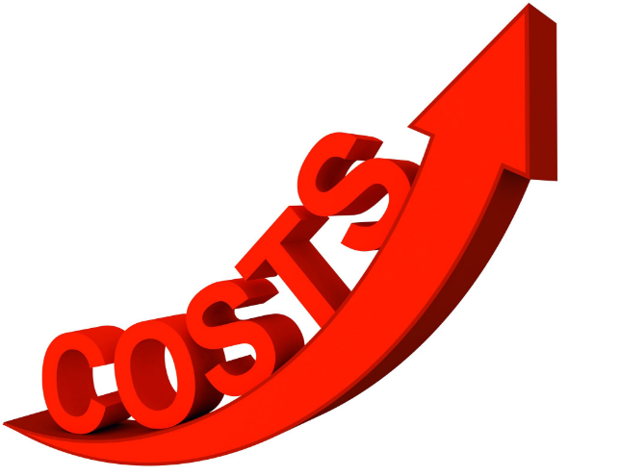
Meetings are time and cost consuming
You need to decide which meeting should be in person, and which can be over the internet

Slide 35

Project Documentation :
Any points discussed or decisions made are formerly documented in order to become part of project documentation.
You should include the results, or at least a summary, of all brainstorming sessions, and decisions made at meetings so that everyone is kept informed of what's going on.

Slide 36
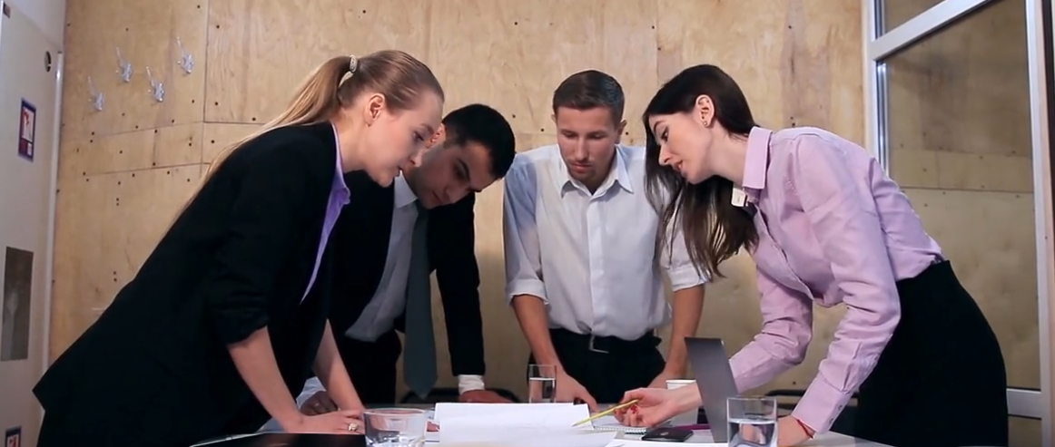
Benefits of communication
establishing the context and objectives of the risk process,
ensuring the interests of all stakeholders are understood and considered,
allowing for risks to be adequately identified across categories,
bringing together different areas of functional expertise when assessing or analyzing risks,
ensuring different and sometimes opposing views are appropriately considered when defining risk appetite criteria, and in evaluating risks, and finally,
Securing broad support for a treatment plan.

Slide 37
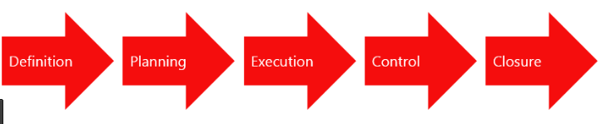
Continuous communication :
You have to continue to communicate :
what you are doing, and
why you are doing it
at every stage of the risk management process.

Slide 38
Knowledge check 1:
Risk monitor and review

Slide 39

Question 1
In which phase of a project's life cycle would project uncertainty be the greatest?
Initiation phase
Planning phase
Execution phase
Closure phase
Explanation
There is an inverse relationship between scope and uncertainty. As less is known about project scope in the earliest phase of the project life cycle, the initiation phase has the highest level of uncertainty.

Slide 40
Question 2
What is the approach for dealing with risk in a project better known as?
A scope baseline
A risk mitigation strategy
A workaround
A risk management plan
Explanation
A project manager needs to develop a risk management plan that helps identify and assess risks, and consider possible ways to deal with those identified risks. A risk management plan should be developed during the planning phase of the project management life cycle, so that plans can be put into place to deal with those risks.

Slide 41
Activity: Risk Management Radargraph
Go to file :
Activity_ Risk Management Radargraph

Slide 42
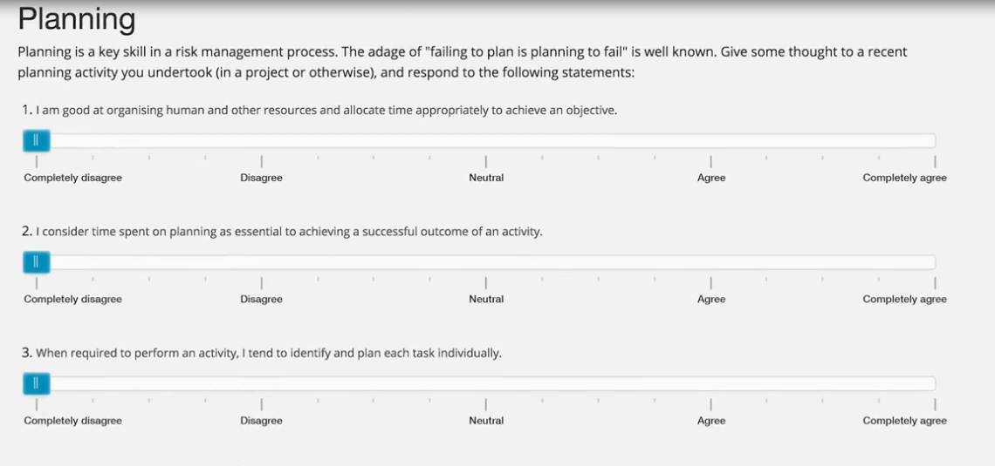
Radargraph dimensions

Slide 43
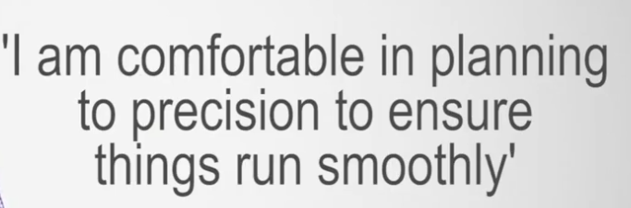
Radargraph dimensions

Slide 44
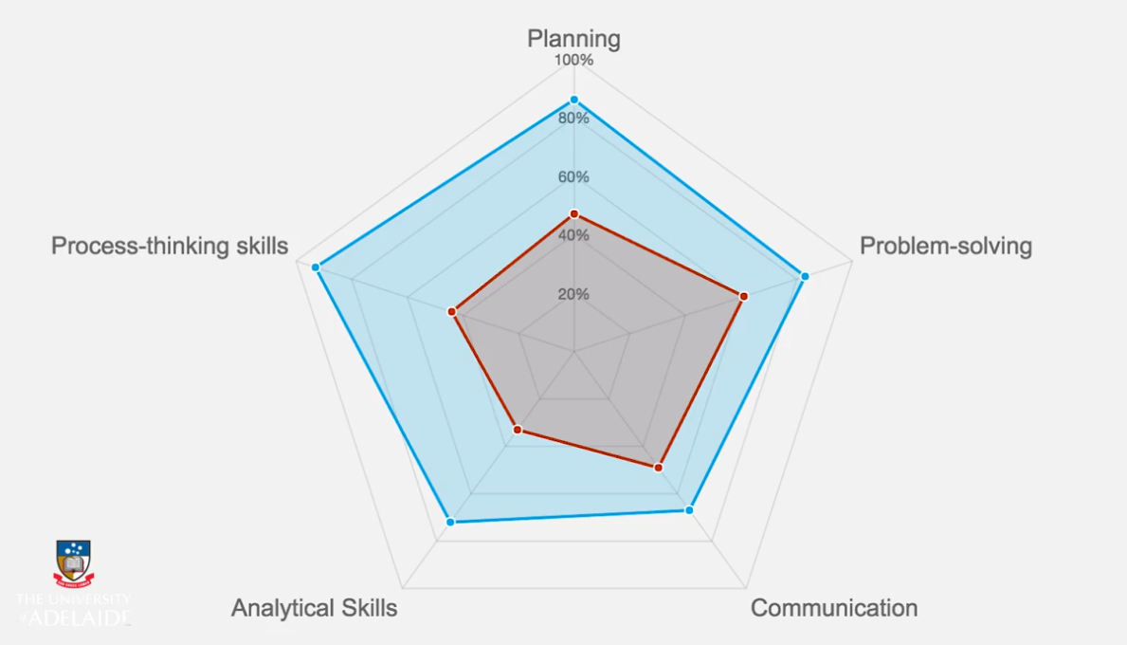
Radargraph dimensions

Slide 45
2 Monitor and review

Slide 46
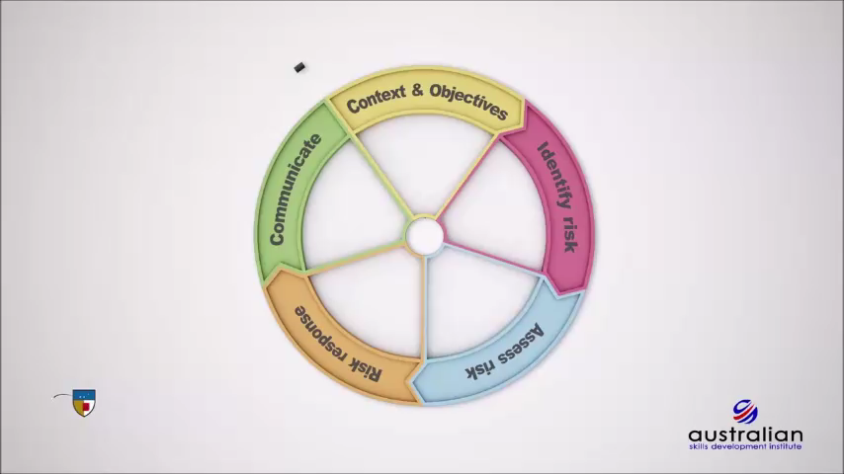
Risk canvas on Monitor and review

Slide 47


Questions that you can ask to determine the robustness of the monitoring and review activities in your project

Slide 48
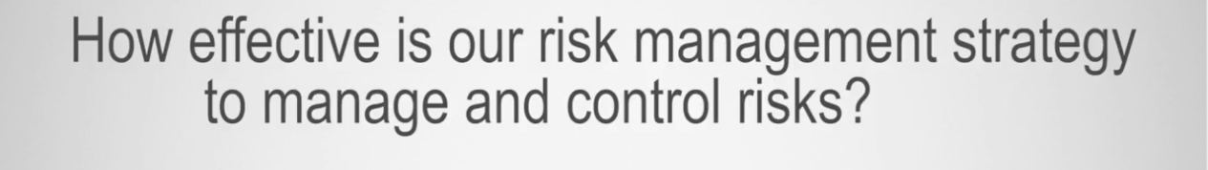

Questions that you can ask to determine the robustness of the monitoring and review activities in your project

Slide 49

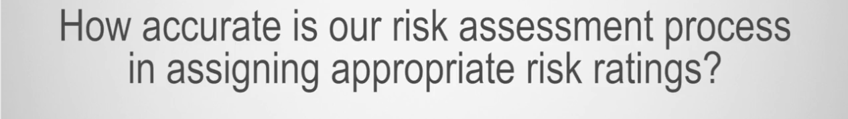
Questions that you can ask to determine the robustness of the monitoring and review activities in your project

Slide 50


Questions that you can ask to determine the robustness of the monitoring and review activities in your project

Slide 51
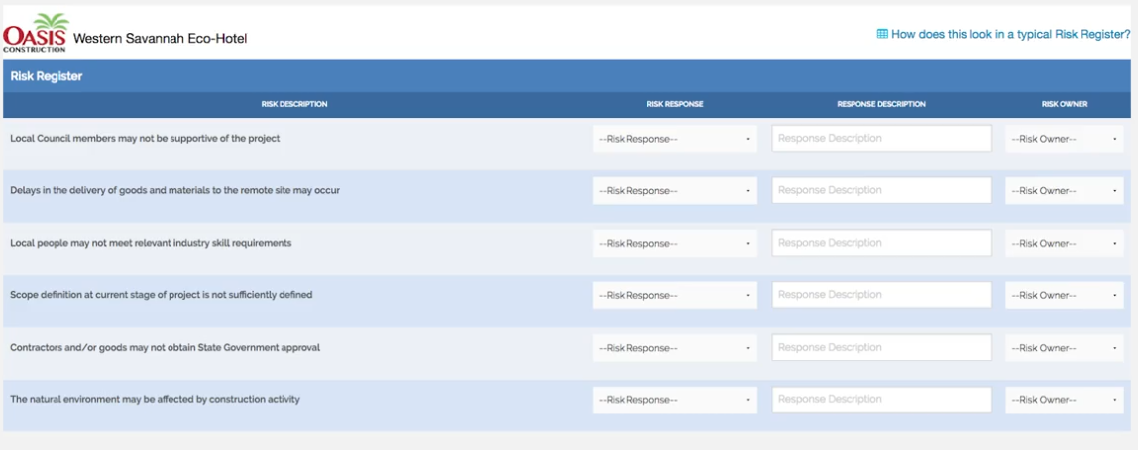

Monitor and review as a continuous process
Monitor and review is a continuous practice that should occur at every stage of the risk management process.
Results should be recorded and reported internally and be an input to the review and continuous improvement of your own risk management processes.

Slide 52


Clear outcome
When you begin the process of managing risk with clear and concise outcomes and what those outcomes will look like, you will then be in a position to monitor and review to ensure those outcomes are met successfully.
As this has planning implications, thinking about how you might go about monitoring and reviewing risks of your project or within your organization needs to occur from the outset to ensure activities are fit for purpose.

Slide 53
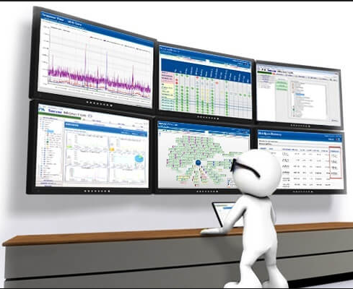
Successful Monitoring:
Successful monitoring and review allows you to track progress towards project outcomes and adjust any stage if necessary.
Tracking progress in a systematic manner at regular intervals supports you in reaching your project objectives.

Slide 54
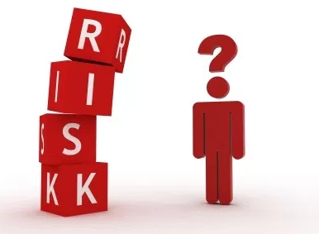
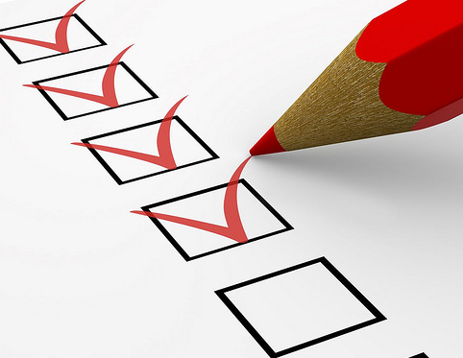

Critical Milestones
Regular review of risk assessment, risk response, and communication with the risk owner enables progress and meeting expectations at critical milestones.
you can determine the success of the treatment of any risk and whether any of the risks have affected project objectives and outcomes

Slide 55

Understanding of the objectives
If you are not clear on the objectives from the outset, the remaining steps may become ineffective.
It is essential to continually review to ensure your objectives remain valid.

Slide 56

Involve your internal and external stakeholders
Create a culture within your project where monitoring and reviewing are critical .
Involving your stakeholders in this activity demonstrates that you value their expertise, evaluations, and findings, which inform your decisions on how you manage risk.

Slide 57
The risk management plan

Slide 60
Knowledge check 2:
Risk monitor and review

Slide 61
Question 3
What is the final stage of the risk management process better known as?
Monitor and review
Reporting
Execution
Closure
Explanation
Remember that monitor and review is a continuous part of risk management.

Slide 62
Question 4
Which of the following actions are part of the risk management process? Identify each valid action.
Defining the roles and responsibilities of team members
Establishing a risk reporting format
Selecting the project manager
Risk sorting and interpretation
Explanation
All of these actions are part of the risk management process.

Slide 63
Question 5
What term is used for "an uncertain event or condition that, if it occurs, has a positive or negative effect on project objectives"?
Risk
Hazard
Bad luck
Disaster
Explanation
Risk is uncertain and inevitable. Risk should not be seen as something negative but rather as something that needs to be responded to throughout the execution of the project.

Slide 64
3 Discussion:
Risk monitor and review

Slide 65
Discuss the challenges you have faced
In this final forum discussion, we would like you to discuss the challenges you face once you have completed all of the risk work on a project. Try to address challenges that relate to who you report to and how often reporting takes place to ensure effective communication, monitoring and review.

Slide 66
4 FAQ

Slide 67
5 Course summary

Slide 68
Feed back

